Slide 1

File Compressor
Muhammad Bilal Khan
380046

Slide 2
What is compression and why do we need it?
The compression is the shrinkage in the size of files. As the size of files is one of few concerns that always remains while handling, computing data etc, thus compressing the size of a file a needed for the real world application.
The real world examples of this phonemeon are 7Zip, Winrar.

Slide 3
Types of compression
1)Lossy Compression:
It explains that lossy compression works by discarding or approximating some original data to achieve a smaller file size.
A key characteristic is that the original data cannot be fully reconstructed after lossy compression.
It gives familiar examples:
JPEG (images): This format reduces file size by removing imperceptible color details.
MP3 (audio): This format reduces file size by dropping inaudible frequencies.
2)Lossless Compression:
It explains that lossless compression allows every bit of the original data to be reconstructed perfectly.
It emphasizes that with lossless compression, there is no missing data.

Slide 4

Huffman Compression
Huffman coding is a lossless data compression algorithm.
The idea is to assign variable-length codes to input characters, lengths of the assigned codes are based on the frequencies of corresponding characters.
Variable-length codes: Some characters get shorter codes, while others get longer ones.
Frequency-based: More frequent characters are assigned shorter codes, while less frequent characters get longer codes. This strategy leads to overall data compression because the more common characters, which appear more often, take up fewer bits.

Slide 5

Contd…
Let’s take input as “ ABAAC”.
Count Frequencies
A=3
B=1
C=1
Take The number with less frequencies

Slide 6




Contd………
5
A:3
Now, build the tree.
Sum the nodes with less
frequencies.
Assign the parent with the sum of
child frequencies.
2
B
C

Slide 7
Contd…..
5
A:3
To transverse to the left from the root, assign 0 and right is assigned as 1.
Now it is encoded as:
A=0,
B=10,
C=11.
2
B
C

Slide 8

Contd……
5
A:3
Now the message will be like this:
2
ABAAC
Original text:- ABAAC
Compressed-
0 10 0 0 11
B
C

Slide 9


Contd..
What do we need to decode this binary string??
We just need the tree and this binary string.
No need to store the ASCII for each repition of word
Original case:
Original text:- ABAAC
Trivial Method:
ASCII code of: A (65), B(66), A(66), A(66), C(67).
Too much memory consuming.

Slide 10
Let’s compare with the help of an example
Text = “AAAAAAAAABBBCC”
14
Character | Frequency | ASCC Bits | Huffman Code | Huffman bits
A | 9 | 9*8 = 72 | 0 | 9 * 1 =9
B | 3 | 3 * 8 = 24 | 10 | 3 * 2= 6
C | 2 | 2 * 8 =16 | 11 | 2 * 2 =4
Total |  | 112 bits |  | 19 bits
A:9
5
B
C
That is ~ 84 % compression.

Slide 11
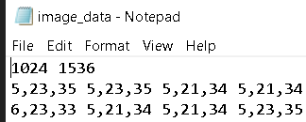
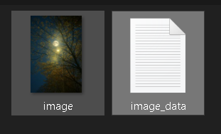
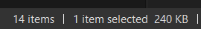
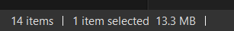


Does the same Works for images??
Short answer, No.
I followed the approach:
Convert the image to the .txt file using python
The image expanded 240kb turned into 13.2 MB

Slide 12
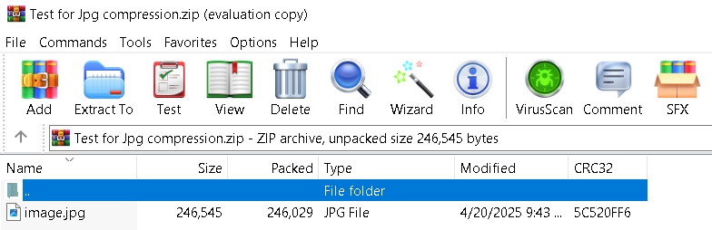
Contd…..
The images are already compressed. Moreover, the ASCII code that we were dealing initially uses 7 bits at max and the images are stored as RGB. And each pixel can have 0 to 255.
The winrar follows the same approach, it cant compress the images.

Slide 13
GUI
The GUI was built using the tinkter library, as its easy to use.
Initiliaze the windows
Capture the input
Call compression func
On clicking Decompress call decompress

Slide 14
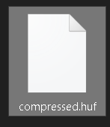
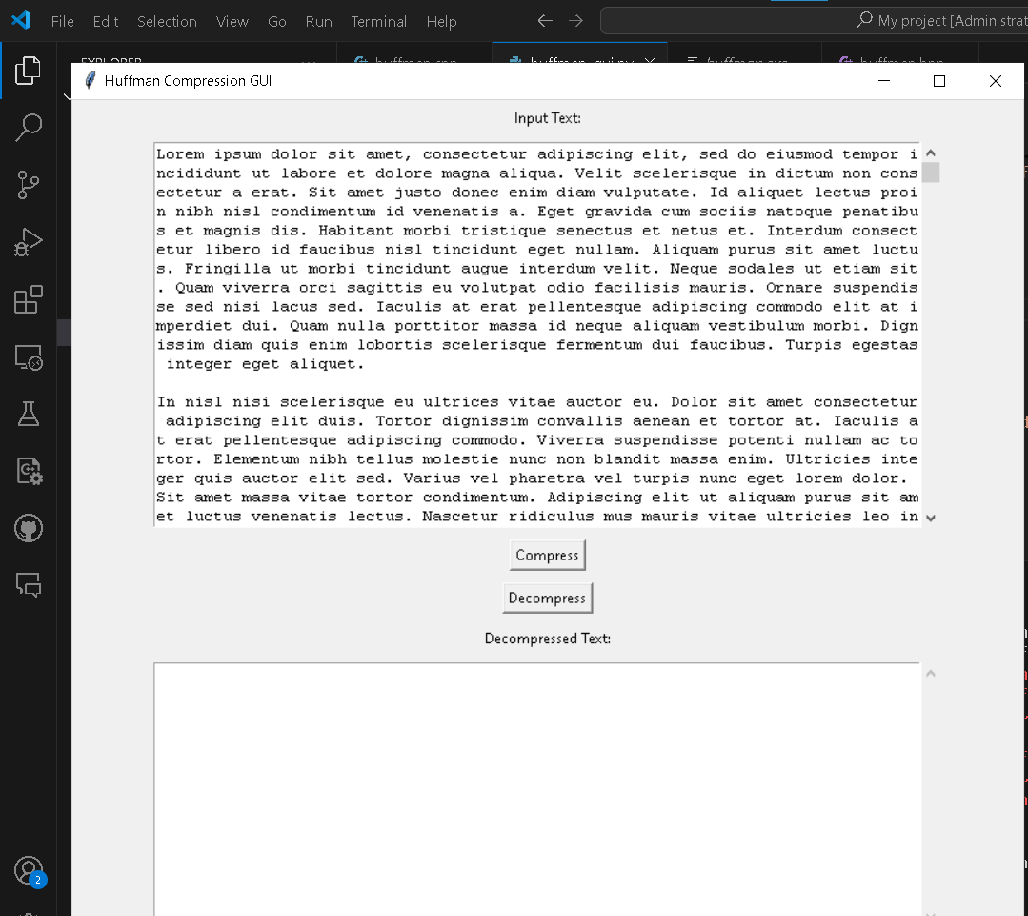
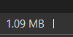
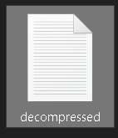
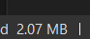





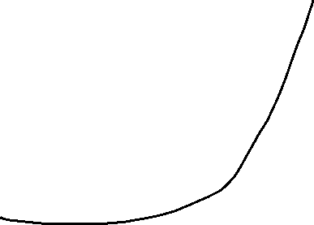



DEMO
3. Compress and it the size becomes 1.09mb.
1. Input 2.07mb random data
2. Copy data and put it in GUI
3. On Decompression, it gets 2.07mb again

Slide 15
Conclusion
Huffman coding is a good technique to compress the data files, without comprising the data.
GUI make it easier to use .
For Future work, the image compression and video compression techniques can be studied, using somewhat similar approach.

